Slide 1
Caltech seminars
Geology Club March 14, 2013, 4 pm
The World According to GARP; Geophysics, Anisotropy and Realistic Physics
According to John Eiler (2003) the question of why volcanoes appear at ocean ridges and “hotspots” is fundamentally a solved problem. Ridges passively tap the ambient convecting mantle while “hotspots” are fed by hot, narrow, actively upwellings from the core-mantle boundary. There is increasing evidence that the upper mantle boundary layer (Gutenberg’s Region B) is not only buoyant (e.g. PREM plus Mark Simons) but is a mélange that includes juxtaposed and laminated lithologies and aligned melt accumulations (LLAMA, J.Pet 2011). The strong anisotropy and heterogeneity of this layer make it polarizing and distorting (and dirty) lens through which we view the mantle and which introduces blue and red streaky artefacts in travel-time tomographic images that can easily be misinterpreted.
Notes:
Caltech seminars
Geology Club March 14, 2013 4 pm
The World According to GARP; Geophysics, Anisotropy and Realistic Physics
According to John Eiler (2003; Inside the Subduction Factory, Geophys. Monogr. Ser., vol. 138) the question of why volcanoes appear at ocean ridges and “hotspots” is fundamentally a solved problem. Ridges passively tap the ambient convecting mantle while “hotspots” are fed by hot, actively upwelling, jets from the core-mantle boundary. Whole mantle convection and deep slab penetration have also been deemed as proved, by visual inspection of color pictures. High-resolution broad-band seismic data, inverted for anisotropy and absolute seismic velocities (as opposed to relative travel times over a limited aperture array), however, suggest that the MORB source is actually in the sinking-slab-induced broad passive upwellings from the transition zone while intraplate volcanoes tap the low-velocity part of the surface boundary layer. There is increasing evidence that the upper mantle boundary layer (Gutenberg’s Region B) is not only buoyant (e.g. PREM plus Mark Simons) but is a mélange that includes juxtaposed and laminated lithologies and aligned melt accumulations (LLAMA, J.Pet 2011). Caltech seminars
Geology Club March 14, 2013 4 pm
The World According to GARP; Geophysics, Anisotropy and Realistic Physics
According to John Eiler (2003; Inside the Subduction Factory, Geophys. Monogr. Ser., vol. 138) the question of why volcanoes appear at ocean ridges and “hotspots” is fundamentally a solved problem. Ridges passively tap the ambient convecting mantle while “hotspots” are fed by hot, actively upwelling, jets from the core-mantle boundary. Whole mantle convection and deep slab penetration have also been deemed as proved, by visual inspection of color pictures. High-resolution broad-band seismic data, inverted for anisotropy and absolute seismic velocities (as opposed to relative travel times over a limited aperture array), however, suggest that the MORB source is actually in the sinking-slab-induced broad passive upwellings from the transition zone while intraplate volcanoes tap the low-velocity part of the surface boundary layer. There is increasing evidence that the upper mantle boundary layer (Gutenberg’s Region B) is not only buoyant (e.g. PREM plus Mark Simons) but is a mélange that includes juxtaposed and laminated lithologies and aligned melt accumulations (LLAMA, J.Pet 2011). The strong anisotropy and heterogeneity of this layer make it polarizing and distorting (and dirty) lens through which we view the mantle and which introduces blue and red streaky artefacts in travel-time tomographic images that can easily be misinterpreted. Anisotropy of the upper 200

Slide 2
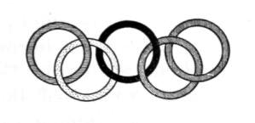


Venn oh venn?
thermodynamics
geology
Fluid dynamics
geophysics
geochemistry
physics
It’s a PLUME!
petrology
seismology
The Noble ones of chemical persuasions
Inhaled the pachyderms exhalations
"Tis from the deep bowels" offered one
"A signature of intestinal fermentations".
"Tis primordial gas", gasped another
We'll get a Nobel prize for our exertations
Or at least a Science paper, with no deliberation!
Happy Birthday
Albert Einstein
b.1879
The invisible elephant parts are often physics, logic & anisotropy
"Nature shows us only the tail of the lion. But there is no doubt in my mind that the lion belongs with it even if he cannot reveal himself” Einstein

Slide 3
Venn oh venn?
thermodynamics
geology
Fluid dynamics
geophysics
geochemistry
physics
It’s a PLUME!
petrology
seismology
The Noble ones of chemical persuasions
Inhaled the pachyderms exhalations
"Tis from the deep bowels" offered one
"A signature of intestinal fermentations".
"Tis primordial gas", gasped another
We'll get a Nobel prize for our exertations
Or at least a Science paper, with no deliberation!
The overlooked elephant parts are often physics, logic & anisotropy

Slide 4
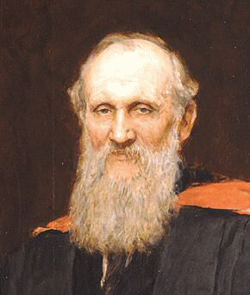
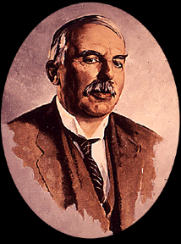
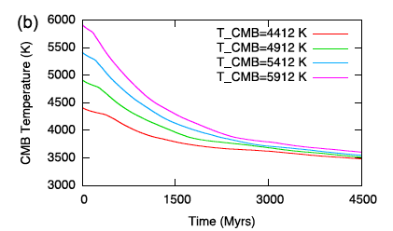
THE MANTLE IS A TOP-DOWN SYSTEM
The Earth is cooling (Lord Kelvin, d.1907); this cooling is modulated & slowed by internal heating
(Lord Rutherford, d.1937).
Both of these effects cause the mantle
geotherm to be subadiabatic, on average.
Plate tectonics (subduction) place cold slabs
in the interior, resulting in cooling from within,
reenforcing the subadiabaticity.
The core & the core-mantle boundary (CMB)
are cooling (thermodynamics).
THE NET RESULT IS THAT THE SURFACE
BOUNDARY LAYER IS SOME 200 K HOTTER
& THE BASE OF THE MANTLE SOME 400 K
COLDER THAN GENERALLY CONSIDERED.
DEEP UPWELLINGS ARE COLD!
Even the core is cooling

Slide 5

Lord Kelvin thought the Earth was cooling & codified the 2nd law of thermodynamics. Both are often ignored in geodynamics.
“All science is either physics or stamp collecting”-Ernest Rutherford

Slide 6
Boundary layer convection
Cooled from above
pull
2898 km
650 km
slabs
push
Heated from the core (standard or canonical model)
…and below
plus thermal overshoot, subadiabaticity…
…plus Kelvin effect, radioactivity & classical physics
Broad dome
CMB

Slide 7
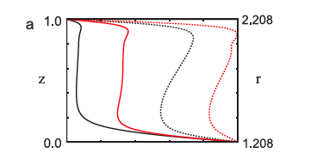
T
Boundary layers
Thermal ‘bump’
A possible source of ‘hotspot’ magmas
Bottom heated
depth
Internal heated
Temporally averaged profiles of laterally averaged mean temperature as function of height above the core for a Rayleigh number Ra = 5 x10⁵. Red curves (plane-layers), black curves (spherical-shells)
Google
subadiabaticity in the mantle
O’Farrell et al. December 3, 2012 GJI

Slide 8
A.
Implications from ‘classical” physics (from A- to Ani-)
(Kelvin, Rutherford, Birch, Debye, Gruneisen)
Non-Adiabaticity-increases upper boundary layer temperatures by ~200 K (thick thermal boundary layer) & decreases deep mantle temperatures by ~300-400 K.
Ambient-ridge (MORB) mantle* is not the ambient shallow mantle under midplate locations (seismology).
An-harmonicity-causes thermal properties to vary with T and P, increases T in upper boundary layer by >200 K, insulates underlying mantle, makes deep buoyancy hard to achieve.
An-isotropy-neglect of creates artefacts in travel-time tomography & inclusion of shows that ~200 km ’plates’ advect laterally & ridges may be fueled from the TZ (>400-km).
*also called ‘the convecting mantle’, ‘the depleted mantle’, ‘DM’, ‘DUM’…

Slide 9
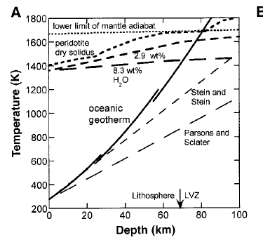
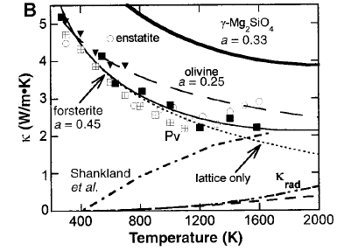
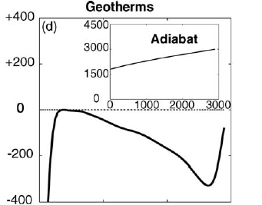
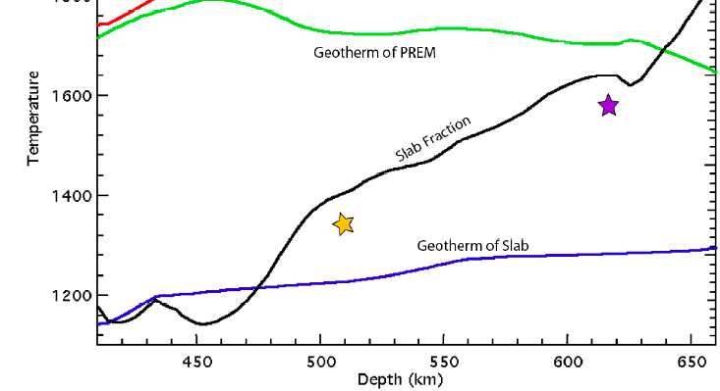
PHYSICS
Boundary layer
HIGHER TEMPERATURES
“classical”
LOWER
CONDUCTIVITY
Interior
geotherm
INTERNAL HEATING
ΔT (K)
Slab cooling
LOWER TEMPERATURES
THERMAL OVERSHOOT
SUBADIABAT
500 km
3000

Slide 10

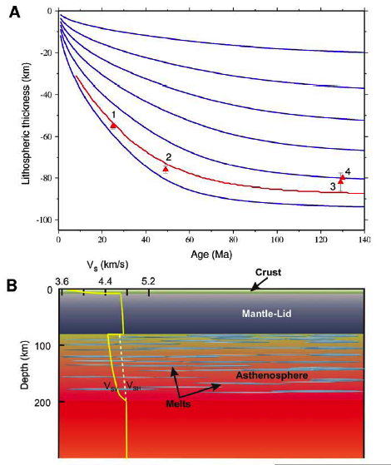
The Shallow Mantle* is a BoundaryLayer (LLAMA)
Laterally Advecting
Laminated Lithologies
Magma Accumulations
Anisotropic
It contains the Lid, Lithosphere
& Asthenosphere
It cannot be ignored, approximated,
corrected out… It is not lithosphere,
asthenosphere, convecting mantle, fertile…
G
L
2% magma (Largest LIPs ok)
*Gutenberg’s Region B
Notes:
Let’s take it from the top.

Slide 11

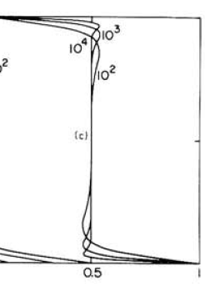
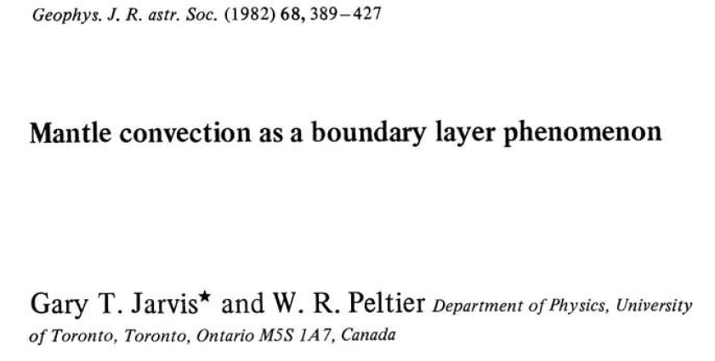
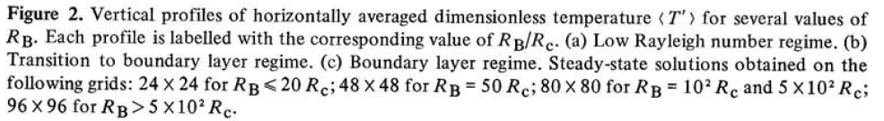
B
Gutenberg’s low velocity zone (LVZ)
Thermal overshoot & BL convection
B
Gutenberg’s Region B
D”
Boundary layers can be buoyancy driven or shear driven, just as in the atmosphere

Slide 12
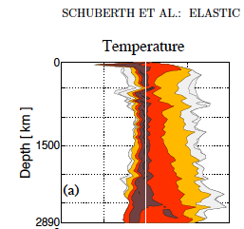
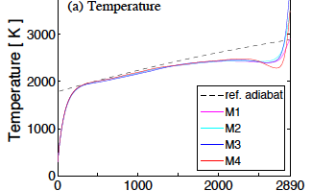
Thermal overshoot & BL convection
Gutenberg’s low velocity zone (LVZ)
B
B
Gutenberg’s Region B
LLAMA
hot
cold
Average T
Highest Tp in the mantle?
T
subadiabat
D”
subadiabaticty
Thermal bump
Boundary layers can be buoyancy driven or shear driven, just as in the atmosphere
Potential temperatures in LLAMA are arguably the highest in the mantle

Slide 13
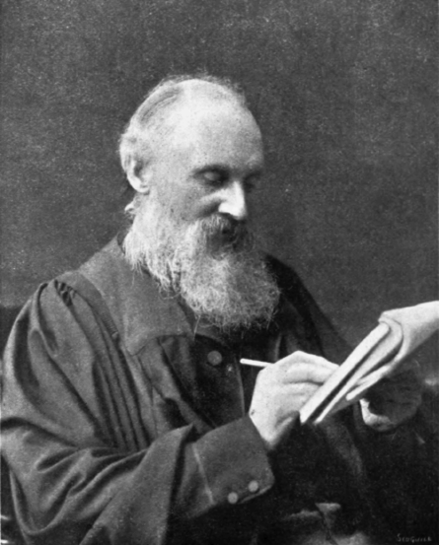
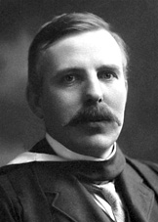
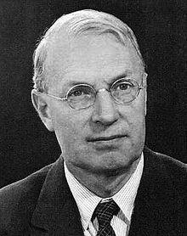
physics
Subadiabaticity* is intrinsic to a cooling planet, modulated by internal heating
Thermal overshoots are intrinsic to convection that involves boundary layers
…reinforced by plate tectonics, subduction of cold slabs, secular cooling, radioactivity…
…& by temperature dependence of physical properties, including viscosity, which extends the cooling lifetime of surface plates & hence, their ability to cool the mantle from below, after they sink
*non traditional (for many) ideas in green, throughout
Canonical Box

Slide 14
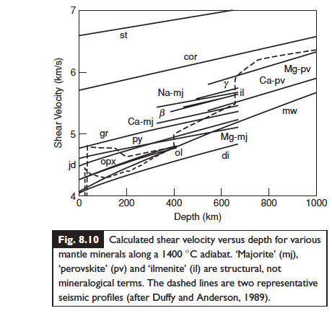
seismology
Shear wavespeeds along adiabats
Observed wavespeeds
Subadiabatic trends
BL

Slide 15
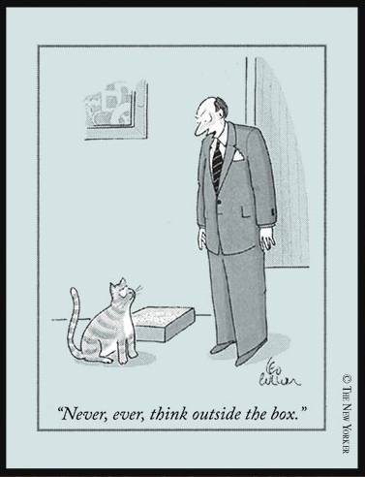
‘Inside-the-box’ physics
An- isotropy
An- harmonicity
An- elasticity
A- sphericity
A- thermal
Anti- adiabaticity
Absolute velocities
Ambient/average mantle
Artefacts
Outside the physics box (a-physical) assumptions
The Paradigm
physics
Isotropy, adiabaticity etc.
Active upwellings
Homogeneity
Isothermality
Thin plates
Pyrolite
1350 ºC
Hawaii, point source
of heat & magm
Canonical
physics

Slide 16
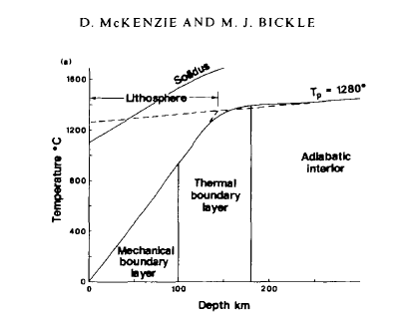
The Canonical 1988 Cambridge Geotherm (abandoned by Cambridge, for good reason, but still widely used as a reference geotherm in petrology)
1988
INCLUDES THE CANONICAL* PETROLOGICAL GEOTHERM & DEFINITION OF “LITHOSPHERE”, “AMBIENT
MANTLE
& “POTENTIAL TEMPERATURE”
A physics-free geotherm unconstrained by seismology
Assumptions: adiabatic & homogeneous below 100 km
constant thermal conductivity
no radioactivity
no Kelvin cooling Earth effects; surface cooling stops at 100 km
no seismology constraints
upper mantle temperatures never exceed MORB temperatures
or the solidus
*in blue

Slide 17
The Canonical 1988 Cambridge Geotherm; an approximation to ridge mantle.
Does it apply to average mantle?
1988
‘ambient’ subplate mantle can be ~200 K hotter than the hypothetical subridge adiabat
CANONICAL
DEFINITIONS OF “LITHOSPHERE”, “AMBIENT
MANTLE
& “POTENTIAL TEMPERATURE”
Assumptions: adiabatic & homogeneous below 100 km
constant thermal conductivity
no radioactivity
no Kelvin cooling Earth effects; surface cooling stops at 100 km
no seismology constraints
upper mantle temperatures can never exceed MORB temperatures

Slide 18

The Central Dogma of mantle geochemistry
& petrology
[McKenzie and Bickle, 1988]
Midocean ridge basalts represent ambient mantle “because they
are due to passive upwellings”
Ambient (background, average) upper mantle potential
temperatures are in the range 1280–1400 C , no higher
Thermal ‘anomalies’ 200–300 C above ‘background’ are
from the deep mantle
Temperature always increases with depth
Hawaii is a point source of heat & magmatism
Tp maxima of oceanic basalts 1450–1600 C are substantially
greater than ambient mantle & imply deep mantle sources
Fuller’s earth
NO RADIOACTIVITY, NO SECULAR COOLING, A HOMOGENEOUS FERTILE PYROLITE MANTLE, A THIN (<100 KM THICK) BOUNDARY LAYER…

Slide 19
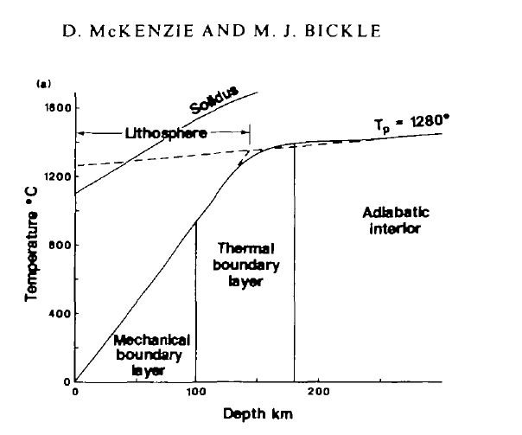

Preview!
(Corrected for physics)
Surface wave seismology
Subadiabat
MORB geotherm
Phonon physics
Non linear
To MORB source
Cannot be fertile peridotite or pyrolite

Slide 20
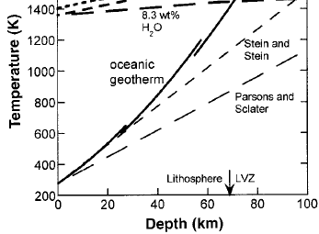
Preview!
(Corrected for physics)
Surface wave seismology
Phonon physics
Subadiabat
Near ridge
OIB
To MORB source
MORB
Ridge geotherm
Phonon physics
T (K)
Cannot be fertile peridotite or pyrolite (too much melting)
Ridge geotherm is “cold” because of subadiabaticity & lack of surface insulation
Non linear
Hofmeister

Slide 21
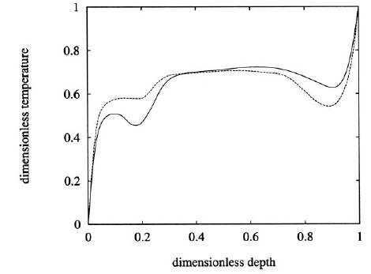
FLUID DYNAMICS
“On the basis of arguments drawn from simple
convective configuration [1], most geochemists
and geophysicists have taken (the) adiabatic concept *dogmatically…mantle is not as adiabatic as has commonly been held by many geophysicists. Such a change in view would seriously impact many fields in the geosciences, such as petrology, geochemistry and mineral physics.”
C. Matyska, D.A. Yuen /Earth and Planetary Science Letters 198 (2002) 471-483
Temperature vs depth
Tackley PJ, Stevenson D J, Glatzmaier GA, et al., 1993
* And whole mantle convection
[1] G.T. Jarvis, D.P. McKenzie, Convection in a compressible
fluid with infinite Prandtl number, J. Fluid Mech. 96 (1980) 515-583.
Jarvis changed his mind (and coauthor) in 1982..McKenzie somewhat later.

Slide 22
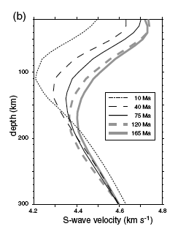
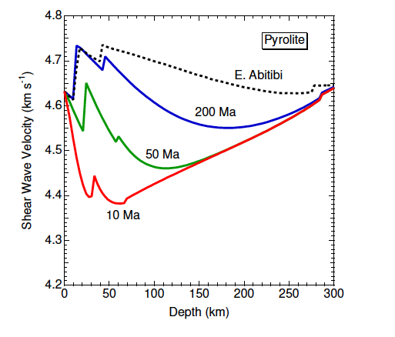
ridges
observed
Depth(km/s)
Depth
100
200
300
Theory (Stixrude)
100
200
300
Age (Ma)
Melt present
10
75
165
adiabat
Near-ridge
observed
4.2
Vs (km/s)
4.8
4.2 4.8
Homogeneous subsolidus isotropic pyrolite mantle, adiabatic at depth
Near-ridge mantle
Shapiro & Ritzwoller
Doesn’t work
Notes:
FIGURE 15: Vedran Lekic a,b,⁎, Barbara Romanowicz. Earth and Planetary Science Letters 308 (2011) 151–160. FIGURE 3. Shapiro & Ritzwoller
Note that below 220 km mantle under 10 Ma plates has higher Vs than mantle under >40 Ma plates. The Vs under young plates increases rapidly with depth below 100 km so that Vs exceeds Vs under older plates by a depth of 180 km. Below 150 km depth the slowest regions of the mantle are not 10 Ma, or 40 Ma crust but 120 Ma, and 75 Ma crust.165 Ma is intermediate.
FIGURE 15: Shapiro & Ritzwoller
Subridge mantle cannot be assumed to represent ambient subplate mantle.
Lateral gradients in seismic wavespeeds, and presumably density and temperature, away from ridges are consistent with relatively cold subridge mantle below 200 km depth. Note that below 220 km mantle under 10 Ma plates has higher Vs than mantle under >40 Ma plates. The Vs under young plates increases rapidly with depth below 100 km so that Vs exceeds Vs under older plates by a depth of 180 km. Below 150 km depth the slowest regions of the mantle are not 10 Ma, or 40 Ma crust but 120 Ma, and 75 Ma crust.165 Ma is intermediate.
<20 Ma crust has high seismic velocities below 150 km !
20 Ma crust and less has high velocities below 150 km !

Slide 23
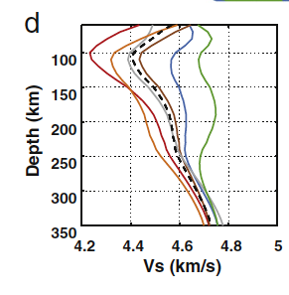
Negative velocity gradient implies large superadiabatic (conduction) thermal gradient
seismology
Depth(km/s)
Depth
100
200
300
100
200
300
Age (Ma)
Melt present
10
75
165
cratons
Near-ridge geotherm may be ‘cold’ at depth
HIGH POSITIVE GRADIENTS
4.2
Vs (km/s)
4.8
Near-ridge mantle
4.2 4.8
Vs (km/s)
High positive velocity gradients imply subadiabatic thermal gradient
Shapiro & Ritzwoller
Lekic & Romanowicz
Notes:
FIGURE 15: Vedran Lekic a,b,⁎, Barbara Romanowicz. Earth and Planetary Science Letters 308 (2011) 151–160. FIGURE 3. Shapiro & Ritzwoller
Note that below 220 km mantle under 10 Ma plates has higher Vs than mantle under >40 Ma plates. The Vs under young plates increases rapidly with depth below 100 km so that Vs exceeds Vs under older plates by a depth of 180 km. Below 150 km depth the slowest regions of the mantle are not 10 Ma, or 40 Ma crust but 120 Ma, and 75 Ma crust.165 Ma is intermediate.
FIGURE 15: Shapiro & Ritzwoller
Subridge mantle cannot be assumed to represent ambient subplate mantle.
Lateral gradients in seismic wavespeeds, and presumably density and temperature, away from ridges are consistent with relatively cold subridge mantle below 200 km depth. Note that below 220 km mantle under 10 Ma plates has higher Vs than mantle under >40 Ma plates. The Vs under young plates increases rapidly with depth below 100 km so that Vs exceeds Vs under older plates by a depth of 180 km. Below 150 km depth the slowest regions of the mantle are not 10 Ma, or 40 Ma crust but 120 Ma, and 75 Ma crust.165 Ma is intermediate.
<20 Ma crust has high seismic velocities below 150 km !
20 Ma crust and less has high velocities below 150 km !

Slide 24
Near-ridge mantle is 200 C colder than under thick plates
Ambient (average)
Depth(km)
Depth
100
200
300
100
200
300
Age (Ma)
Melt extraction range
10
75
165
Near-ridge geotherm is cold
L
BL
4.2
Vs (km/s)
4.8
Near-ridge mantle
4.2 4.8
Vs (km/s)
Shapiro & Ritzwoller
Lekic & Romanowicz
Notes:
FIGURE 15: Vedran Lekic a,b,⁎, Barbara Romanowicz. Earth and Planetary Science Letters 308 (2011) 151–160. FIGURE 3. Shapiro & Ritzwoller
Note that below 220 km mantle under 10 Ma plates has higher Vs than mantle under >40 Ma plates. The Vs under young plates increases rapidly with depth below 100 km so that Vs exceeds Vs under older plates by a depth of 180 km. Below 150 km depth the slowest regions of the mantle are not 10 Ma, or 40 Ma crust but 120 Ma, and 75 Ma crust.165 Ma is intermediate.
FIGURE 15: Shapiro & Ritzwoller
Subridge mantle cannot be assumed to represent ambient subplate mantle.
Lateral gradients in seismic wavespeeds, and presumably density and temperature, away from ridges are consistent with relatively cold subridge mantle below 200 km depth. Note that below 220 km mantle under 10 Ma plates has higher Vs than mantle under >40 Ma plates. The Vs under young plates increases rapidly with depth below 100 km so that Vs exceeds Vs under older plates by a depth of 180 km. Below 150 km depth the slowest regions of the mantle are not 10 Ma, or 40 Ma crust but 120 Ma, and 75 Ma crust.165 Ma is intermediate.
<20 Ma crust has high seismic velocities below 150 km !
20 Ma crust and less has high velocities below 150 km !

Slide 25
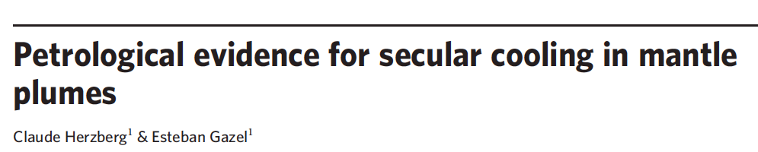
LATERAL TEMPERATURE GRADIENTS
Subridge mantle is not ‘average’, or ‘representative’ or ”ambient” at any depth.
Modeling shows that it is colder than “ambient” subplate mantle at all depths, in spite of containing more melt at shallow depths.
(sources of OIB)
Midplate volcanoes tap the surface boundary layer at various depths (rather than a cooling deep source)
versus

Slide 26

Inverted geotherms
Subadiabatic gradients
Thermal overshoots (ambient mantle is hotter than MORB)
Theory, starting with Raymond Jeanloz, (Moore, Tackley, Bunge, Sinha, Butler, Morris) & wavespeed gradients (Birch, Xu) inferred from seismology, imply ‘thermal overshoots’ & subadiabatic gradients between boundary layers, giving lower potential temperatures at depth than occur near 200 km.
When the canonical geotherm (McKenzie & Bickle) is corrected for physics & seismological oversights, both the possibility of & need for hot deep upwellings disappear.

Slide 27
INVERTED GEOTHERMS
27
BOUNDARY LAYERS TURNING HORIZONTAL,
INSULATION
HEATING WHILE RISING
(Internal heating of passive upwellings)
SUBDUCTION &
SECULAR COOLING
(cooling from below)
Subadiabaticity explains high gradients of seismic velocity below ~200-km depth

Slide 28
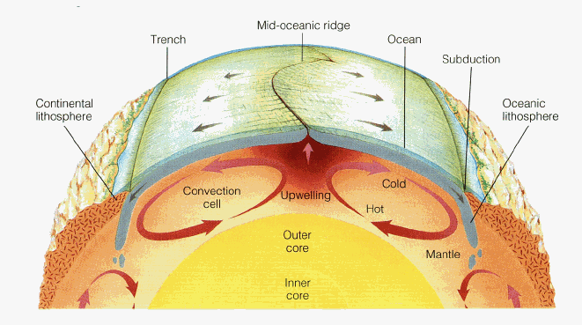
A Kelvin-Rutherford Physics Based Earth
preview
hot
<2000 km
hot
ambient
cold
Lower mantle
cold
In an internally heated planet, cooled from above by conduction & from within by cold slabs, upwellings are broad, passive, cold, sluggish…& subadiabatic
Ambient shallow subplate mantle is insulated & warmer than deeper regions affected by subduction.

Slide 29
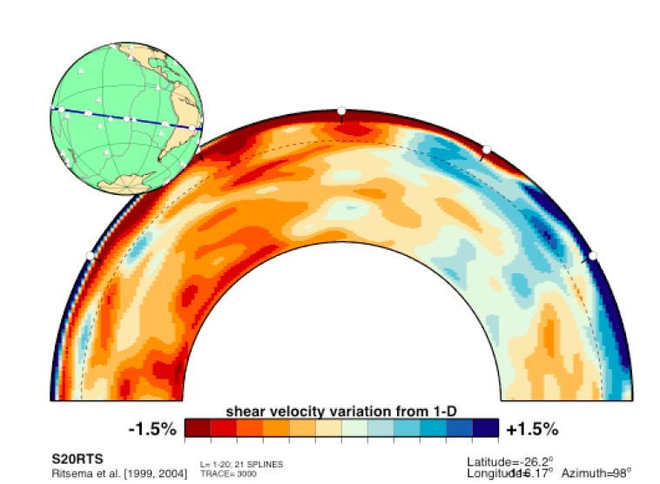
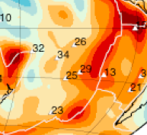
RIDGES ARE VERY BROAD AT 100-150 km depth
Note where the hotspots (numbers) are (in red)
100 km depth
Ponded slabs cool off top of lower mantle

Slide 30
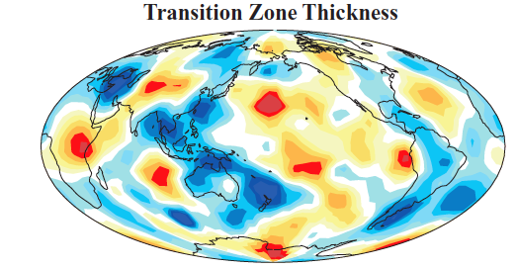
slabs
Flat slabs are the rule
Flat slabs at 650 km cool off the mantle & thicken the TZ
Slide 2
Blue is thick, cold

Slide 31
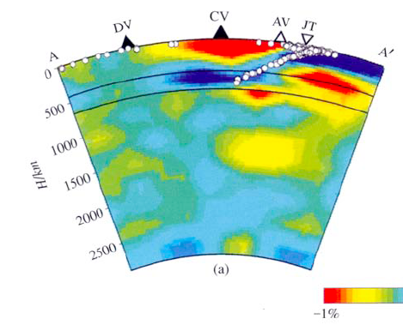
Note ‘red/yellow things’ under 650…are not necessarily connected to top
Changbai Volcano
A continental ‘hotspot’ unconnected to deep mantle

Slide 32
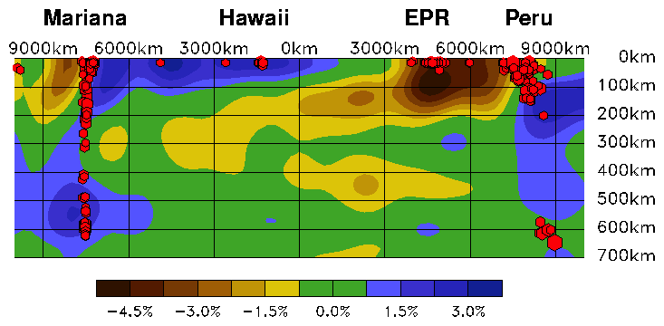
Ridges & slabs
Anisotropic inversions for absolute seismic velocities
200
400
600
Depth
(km)
L
cold warm cool cold
Subsolidus passive upwellings are essentially invisible in isotropic tomography
Note: Hawaii is not particularly impressive; also true in regional models.
Notes:
FIGURE 4 : High-resolution seismic cross sections from all the major seismological research groups do not support the ideas that slabs and hitspots extend across the 650 km discontinuity (Ekstrom, Dziewonski, (FIGURE 2)Ritsema, Allen, Trampert, Spetzler, Maggi…).FIGURE 2
There are lateral gradients in seismic wavespeeds away from ridges that are consistent with relatively cold subridge mantle below 200 km depth. The proximity of the East Pacific Rise (EPR) to the Peru-Chile subduction zone may also contribute to cold mantle under the EPR. In any case, subridge mantle cannot be assumed to represent ambient subplate mantle.
Based on Ekstrom, Dziewonski. There are lateral gradients in seismic velocity away from ridges that are consistent with relatively cold subridge mantle below 150 km depth. The proximety of the EPR to the Peru-Chile subduction zone may also contribute to the cold mantle under the EPR.
High-resolution seismic cross sections from all the major seismological research groups do not support the ideas that slabs and hitspots extend across the 650 km discontinuity (Ekstrom, Dziewonski, (FIGURE 2)Ritsema, Allen, Trampert, Spetzler,(FIGURE 5) Maggi…).FIGURE 2

Slide 33
Seismic & residual bathymetry data are consistent with anomalously cold mantle in a broad band surrounding spreading ridges (ΔT –250 K relative to subplate mantle & some volcanic islands).
Ambient upper mantle temperatures below the central Pacific & other large long-lived plates are up to +200 K higher than under ridges. Source temperature variations reflect different depths of magma extraction from a 200 km thick refractory boundary layer. This does not imply widespread melting & ‘many Hawaiis’; volcanism depends on lithospheric stress & melt content; magma temperatures depend on depth; physical properties of LLAMA are consistent with a mechanical mélange with <2% magma.
Volcanic fields of exclusively alkalic basalts from cooler mantle are simply from shallower depth.

Slide 34
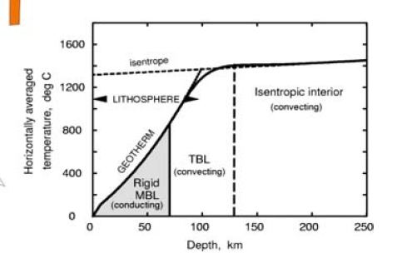
1988 geotherm corrected for physics & seismology
200 km 400 km
1600
1200
midplate
Ridge adiabat
Boundary layer
T
ºC
LLAMA(shearing)
Plate (advecting)
L
Depth
Aside: Every point on these geotherms, even the conduction & subadiabatic parts, can be assigned a potential temperature, Tp.
Notes:
FIGURE 3; Schematic geotherms for ambient midplate mantle and cold near-ridge upwellings. There is not a single geotherm in a convecting mantle.
The main upwelling is the spreading-induced ridge adiabat. The midplate geotherm includes the ~200 km conduction layer, the thermal bump, and the subadiabatic
region below. The system is driven by subduction of part of the BL.
Theoretical temperature profiles between boundary layers are subadiabatic due to internal heating and diverge by as much as 500 K from canonical geotherms. The seismically observed high-wavespeed gradients require particularly strong subadiabats, enhanced by slab cooling at depth. Passive upwellings from great depth therefore start out much colder than usually assumed, which eliminates one of the assumptions underlying the plume hypothesis. The highest accessible temperature in the mantle may occur in the well-known but usually ignored thermal overshoot at the base of the upper mantle BL, near 200 km depth. This would explain the global minimum in VSH that occurs at this depth.

Slide 35
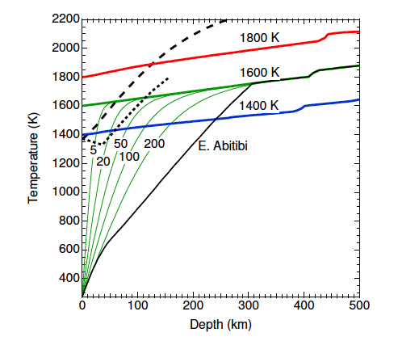
1800 K
Adiabats from source
MIDPLATE
RIDGE
craton
m.y.
Thermal max at 200 km?
This will not work, of course, if the upper mantle is pyrolite or fertile peridotite; too much melt!
Modified from
Stixrude & Lithgow-Bertelloni 2004
Notes:
Figure 2. (bold lines) Computed isentropes with indicated
potential temperatures, (light lines) oceanic thermal boundary
layers computed with the half-space cooling model for indicated
lithospheric ages in millions of years, and the continental
shield geotherm of Jaupart and Mareschal [1999]. The dry
(long dashed) [McKenzie and Bickle, 1988; Zhang andHerzberg,
1994] and moist (short-dashed) [Hirth and Kohlstedt, 1996]
(H/Si=810 ppm) peridotite solidi are shown for comparison.

Slide 36
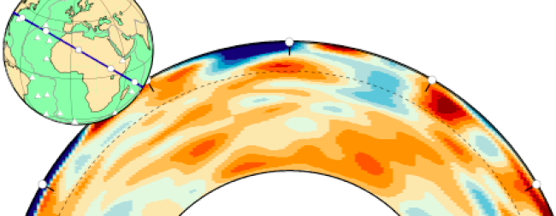
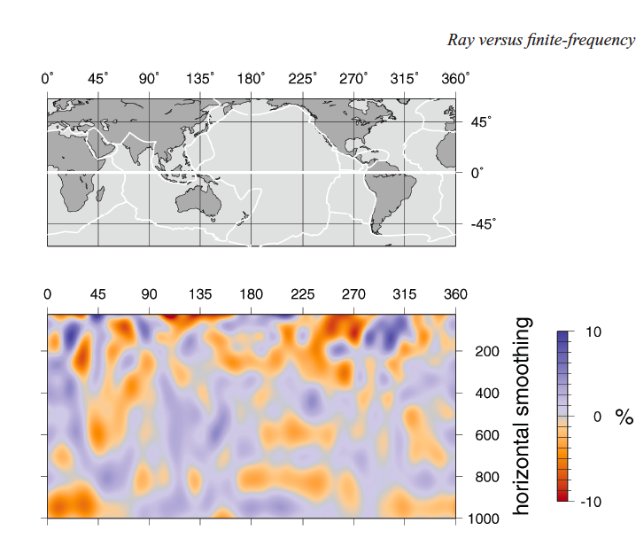
EAR
Hints that ridge upwellings, especially immature ridges, may originate in the transition region
L
VSV>VSH
Notes:
High-resolution seismic cross sections from all the major seismological research groups do not support the ideas that slabs and hitspots extend across the 650 km discontinuity (Ekstrom, Dziewonski, (FIGURE 2)Ritsema, Allen, Trampert, Spetzler,(FIGURE 5) Maggi…).FIGURE 2
Surface wave tomography: finite-frequency effects lost in the null space
Authors: Trampert, J. & Spetzler, J.(2006) FIGURE 5
Journal: Geophysical Journal International, Volume 164, Issue 2, pp. 394-400.Note that ridges apparently extend into the TZ and sometimes it is high wavespeed there

Slide 37
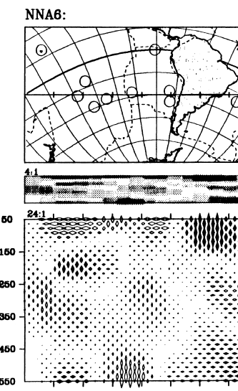
Broad deep upwellings under ridges?
fabric
(Nataf, Nakanishi, Anderson, Romanowicz, Trampert)
anisotropy
Passive upwellings below the solidus are invisible to isotropic tomography…but show up as VSV>VSH anisotropy
anharmonicity
adiabaticity
4:30

Slide 38
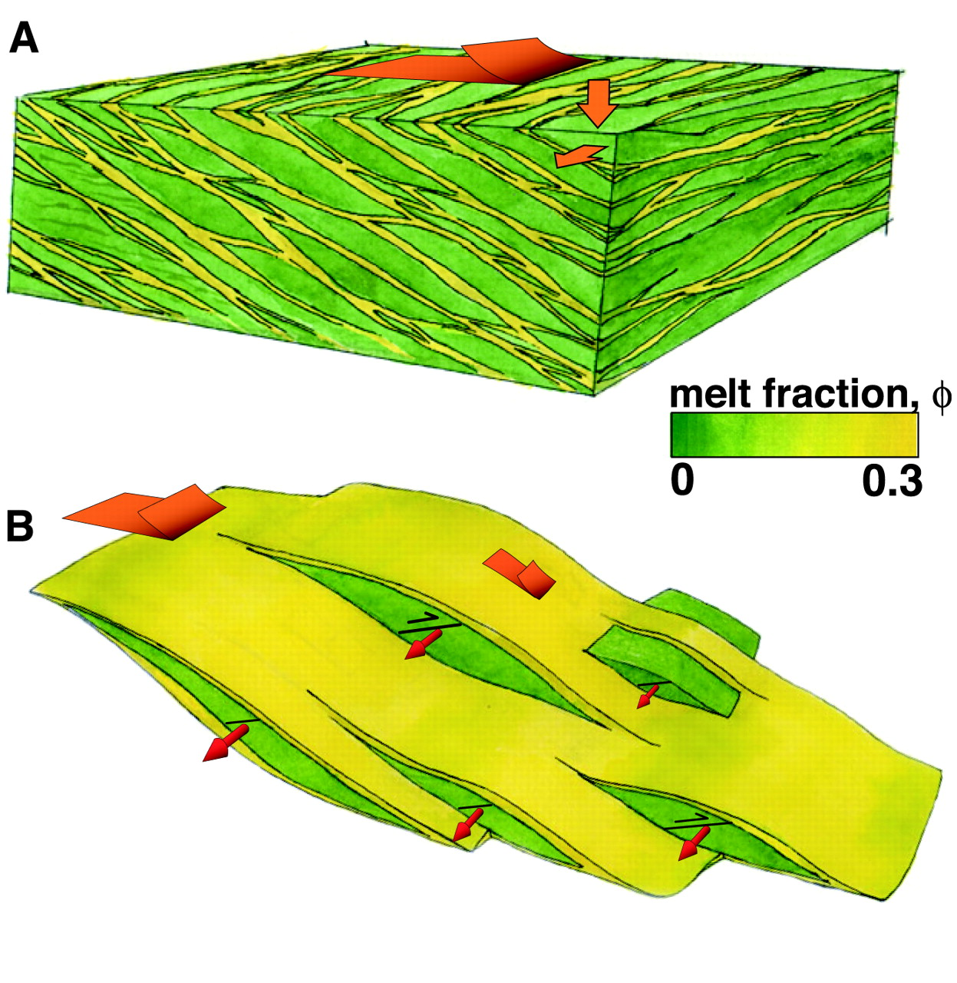

Fig.3. Representation of observed melt distribution and internal strain partitioning in experimentally deformed samples.
fabric
U.Minnesota
Upper 200 km of the mantle is not fertile peridotite with ~15% potential basalt
Hz+EM+FOZO+…
Laminated lithologies (LL)
with 1-2% aligned melt
aggegations (AMA) explains
wavespeed & anisotropy in
LLAMA & LIPs
B K Holtzman et al. Science 2003;301:1227-1230
B.K.Holtzman et al.
Published by AAAS
Notes:
Representation of observed melt distribution and internal strain partitioning in experimentally deformed samples. (A) Synthesis of the configuration of melt bands. Bands form anastomising networks with larger bands at higher angles relative to the shear plane (flat red arrow) connected by smaller bands at lower angles. Smaller arrows indicate that the samples flatten and widen with shear. In three dimensions, the melt-rich layers connect and surround melt-depleted lenses. (B) Strain partitioning between bands (anastomosing layers) and lenses. The flat arrows indicate the total shear and the component concentrated in the bands. The narrow arrows indicate alignment of olivine a axes normal to the shear direction in the lenses. The black lines mark the orientation of the shear plane in the lenses, “back-rotated” relative to the sample shear plane due to strain partitioning.

Slide 39
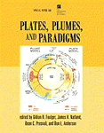
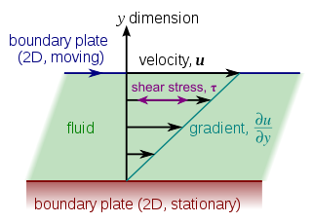
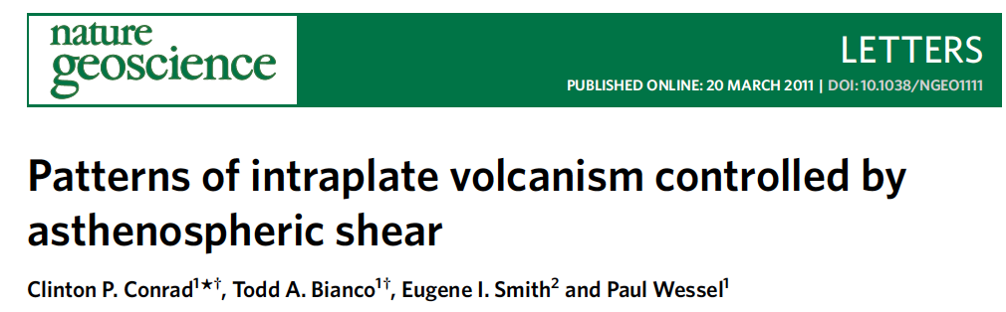
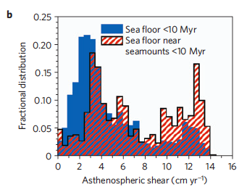
On the shallow origin of hotspots and the westward drift of the lithosphere
Carlo Doglioni et al.
Geological Society of America Special
Papers, 2005, 388, p. 735-749
Stress-driven magma segregation & midplate volcanism from shallow sources

Slide 40
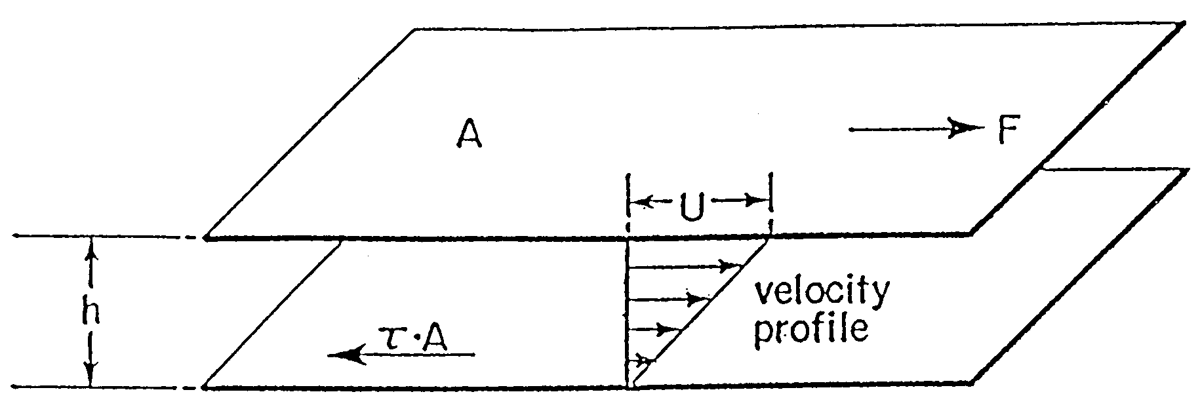
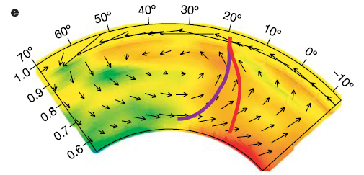
Shallow OIB sources
PLATE model
The hottest & most fixed part of the mantle?
Mantle wind?
Burke’s CMB hypothesis
Steinberger's Mantle "Wind"
CORE
PGZ
Mantle drift history.
Violet line is a fixed source & the red line is a moving source
The deeper the source the less likely it is to appear fixed.
Sources at 200 km depth
can create parallel volcanic
chains (J.Tuzo Wilson.
W.Jason Morgan)

Slide 41
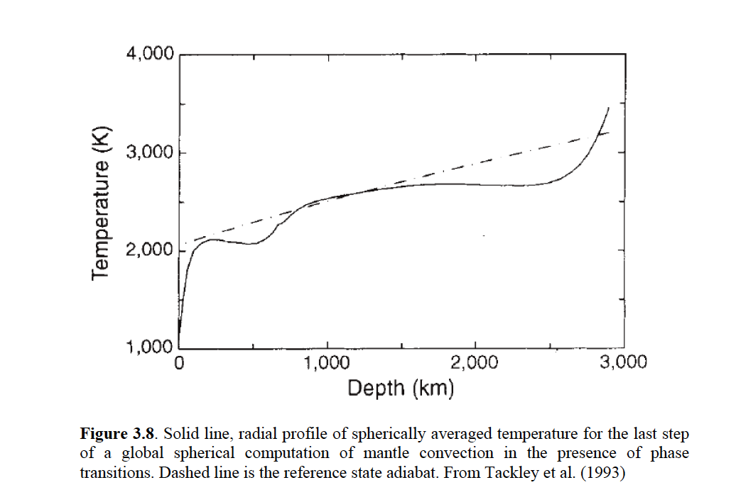
Subadiabats are inferred from thermodynamic first principles & convection simulations as well as from seismology
The average geotherm is not an adiabat (7 slides)
Cold passive upwellings
box
Adiabatic mantle
Rapid upwellings & downwellings can be adiabats but they are narrow

Slide 42
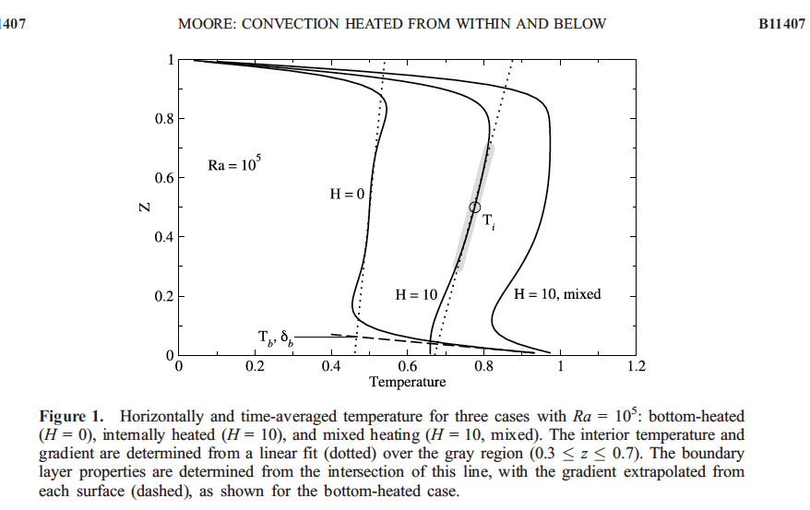
Laterally averaged geotherms
B
Earth-like
canonical
(“narrow downwellings, broad upwellings; thick surface BL)
No internal heating
Thin BL
650 or CMB
TZ or D”

Slide 43
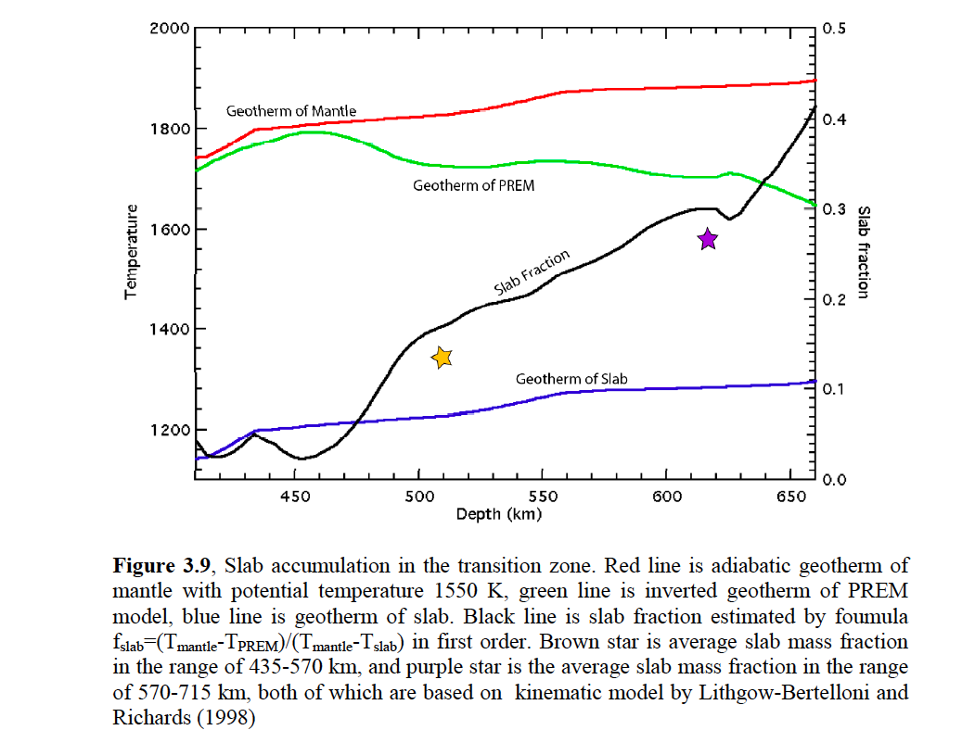
The inferred T at 650 km depth of PREM & other models is ~200 K less than predicted for a 1550 K adiabat..
adiabat
Geotherm inferred from PREM
slab
Xu
Modeled geotherms (from seismic velocity gradients, internal heating & slab accumulation models) decrease with depth
Notes:
The inferred T at 650 km depth of PREM and of regional models is ~200 K less than predicted for a 1550 K adiabat.. Rapidly subducted slabs introduce
material into the TZ that can be 500 K colder than ambient mantle.
The TZ is cooled and fertilized continuously by downgong slabs and migrating trenches.

Slide 44
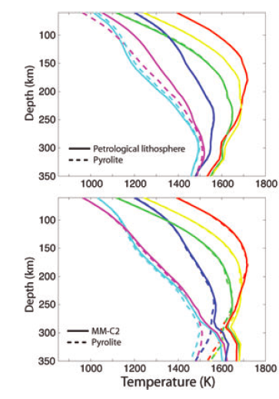



Regional & global seismic models yield higher thermal gradients & temperature in the BL & lower thermal gradients & temperatures below 200 km than Canonical Geotherms
Geotherms inferred from high-resolution seismic models
BL
BL
Region B
Conductive
LVZ
Temperature can decrease with depth!
Canonical box
HOT
Area of 1988 Cambridge subplate geotherm
?
COLD
Next…anisotropy
Notes:
Figure 1. Global Tectonic Regionalization (GTR1) model (Jordan 1981).
S, Q and P are, respectively, precambrian shield and platforms, phanerozoic
orogenic zones and magmatic belts and phanerozoic platforms. A, B and
C are young (0 to 25 Myr),[red, yellow, green] intermediate (25 to 100 Myr) or old (>100
Myr) oceanic crust. The colour scheme is used for all regionalized T and "
profiles shown afterward….blue, purple cratons, shields…

Slide 45






The upper mantle is very anisotropic. Particularly under Hawaii
Ridges are broad, at 100-200 km depth & most hotspots are in these LVAs
VSH>VSV
VSV>VSH
Notes:
FIGURE 3
Fig. 1. Location of the West Pacific Seamount Province (WPSP) and the Musicians seamount trail. The South Pacific Isotopic and Thermal Mantle Anomaly (SOPITA), the DUPAL isotopic mantle anomaly, and the present day active hotspots of the Pacific Ocean (filled circles) are plotted for reference.Earth and Planetary Science Letters
Volume 163, Issues 1–4, November 1998, Pages 53–68
The Magellan seamount trail: implications for Cretaceous hotspot volcanism and absolute Pacific plate motion
Anthony A.P. Koppers^{a,} , Hubert Staudigel^{a, b}, Jan R. Wijbransª, Malcolm S. Pringle^{a, c}

Slide 46

Beno Gutenberg’s Region B; the upper boundary layer
Maximum anisotropy
Minimum VSV
(maximum
melt content)
SV
SH
1-2 % melt
<1800 K
Adiabatic-not
Pyrolite-
not
subadiabat
6-12ºC/Km
Therefore hotter than MORB
Therefore refractory (Hz)
Boundary layer is >>100 km thick
Therefore hotter than 1300ºC

Slide 47

Central Pacific
Ritzwoller
The laminated upper mantle
Vs (T)
T
G₁
Vs(T,f)
f
SH
G₂
Boundary layer
SV
VSH>VSV
Vs(T)
L
Not pyrolite
~1600ºC*
f=V₂/V₁< 2%
VSV=VSH (slow)
Decrease of Vs with depth due to high conduction thermal gradient and the variation of melt-rich layer thicknesses and number
ρ(VSH)²~G₁ , ρ(VSV)²~G₂/f
*Note: contrary to some petrologists, there is nothing wrong with Tp=1600 C at 200 km if the boundary layer is harzburgite with ~2% melt rather than pyrolite.
Notes:
Bonus figure

Slide 48


Potential layers (lithologies)
Tp(t)
Along 1600 K adiabats
Harzburgite
Eclogite
FeO-rich
Pv, post-pv, (Mg,Fe)O
density
Active layer
perovskitite
LLAMA (shearedlayer)
Cooling CMB
Depth (km)
BAM
Lower mantle is enriched in silicon, which implies chemical stratification & layered-mantle convection with limited or no mass transport between upper & lower mantles (Anderson, Murakami, Hamilton…)
CMB

Slide 49



Slab ponding turns a phase change into a chemical boundary
Lower mantle is enriched in silicon, which implies chemical stratification & layered-mantle convection… consistent with ponded or trapped slabs
(Anderson, Murakami…)
Large parts of the upper mantle are cooled from below

Slide 50
Density wavespeed
Harzburgite
(Hz) [with 1-2% melt]
Vs
piclogite
‘red’ but not hot
Accumulated oceanic crust
This is the stratigraphy for a density stratified mantle
Notes:
Harzburgites and dunites are less dense than pyrolite and fertile peridotites. Eclogites and Hawaiian lherzolites are even more dense, but they can be trapped above the beta spinel phase boundary. Some arclogites can be trapped above 500 km depth, while many MORB eclogites can be trapped at 650 km.

Slide 51

Vinnik, L., Foulger, G. L. & Du, Z. (2005).
REGION B
Ancient garnet-rich residues (MORB source?)
Layered transition region
REGION C
Regional mean is ‘fast’ (cold) in slab overridden regions (e.g. WUSA)
Accumulated oceanic crust
Notes:
Using the calibration curves proposed by Hirth & Kohlstedt
(1996; their fig. 3) the temperature at a depth of 160 km beneath
the Afro-Arabian hotspot was estimated by Vinnik et al. (2004) to
be ∼ 1550 ◦C, or 120 ◦C higher than the temperature adopted by
Hirth & Kohlstedt (1996) for MORs at this depth. Applying the
same reasoning gives beneath peripheral regions of Iceland a potential
temperature of ∼ 1400 ◦C, or ∼50 ◦C higher than that assumed
by Hirth and Kohlstedt for MORs. A higher mantle temperature
beneath the Afro-Arabian hotspot is consistent with the lower S velocity
there (Fig. 3). Variations in water content could also affect the
depth of onset of wet melting. The water content in the upper mantle
beneath Iceland is poorly known, however, and the most recent
estimate is ∼600–900 ppm (Nichols et al. 2002). Variation in water
content within this range could account for up to ∼ 15 km variation
in the depth of onset of melting.

Slide 52

Whole mantle convection, homogeneous pyrolite
mantle, fixed CMB temperature,adiabatic gradients
…do not satisfy first order features of
seismic models
“However, we do not intend to fit seismic reference profiles.” (Schuberth et al.)*
…published simulations “are intended to give theoretical guidance about the influence of different parameters rather than be realistic representations of the actual Earth” (Schuberth, Tackley).
*Seismic gradients are underpredicted and the depth of the 410 km discontinuity is overpredicted…absolute T and temperature gradients are overestimated.
(also, no magnetic field)

Slide 53


IF THE MANTLE IS FORCED INTO A WHOLE MANTLE CONVECTION MODE & THE MANTLE & CORE ARE NOT ALLOWED TO COOL* THERE WILL BE NO MAGNETIC FIELD & GLOBAL SEISMIC MODELS ARE
NOT SATISFIED
25 km resolution, global, thermodynamically consistent, mainly subadiabatic
Whole mantle enforced, no self-organization, constant temperature CMB
O
O
I would worry
*e.g. canonical model
Does not agree with 1D model (seismic velocities, gradients); no magnetic field

Slide 54
island arc basalts
backarc basin basalts
underplate
Ridge suction
Sheared boundary layer
LLAMA
Low wavespeeds
TZ
Secondary downwellings
Passive upwellings
(not self-driven)
Athermal explanation of tomographic results
Notes:
FIGURE 6; Schematic of the plate tectonic cycle. The surface BL (red) contains aligned melt accumulations that are the source of within-plate magma. Sediments and some slab fluids (yellow) exit the slab at shallow depths and are incorporated into LLAMA. The residual depleted slabs (blue) enter the TZ, displacing older eclogite cumulates (green), which are entrained into subridge flow. Part of the reason for the heterogeneity of the outer 200 km of the mantle is the presence of melt and the accumulation of volatiles and of buoyant recycled products, which include refractory infertile olivine-rich residues and fertile enriched low-melting components. Instead of being homogenized to a fine scale by vigorous convection, these are juxtaposed, but segregated by shear, into a large-scale mélange. A sheared polyphase aggregate becomes baklava, not marble cake.

Slide 55



RIDGE
The plate tectonic cycle
Harzburgite (Hz) stays in or is returned to the shallow boundary layer (re-used ‘lithosphere”)
MORB source is displaced & entrained up (passive upwelling)
Dense cold eclogite stays at bottom of TZ
VERY COLD
Hz
LLAMA Harzburgite
Hz
TZ piclogite
Hz
Au Revoirsevoir
Oceanic crust accumulates at base (au revoir)
Harzburgite rises out as it heats

Slide 56


Most of the Atlantic and Indian ocean hotspots are embedded in shallow bands related to spreading ridges, past or present. Hotspots favor near-ridge locations. If the migration of ridges is taken into account, the close association of hotspots with ridges, present and recent, is even more impressive*.
Most hotspots lie near the edges of LVAs or in high-velocity anomalies. Many VLVAs are not near hotspots.
Many hotspots are underlain by colder than average mantle below 200 km...
The upper 200 km of the mantle is heterogeneous & anisotropic
* p=10⁻⁸
(Using Burke’s parameters)

Slide 57



Artefacts
Seismic waves
Why do so many people concentrate on the deepest mantle (D”) rather than Gutenberg’s region B?
A brief diversion into Artefacts
Teleseismic Transmission Travel Time Tomography
earthquake

Slide 58
Seismometers on surface
Artefacts
four
examples
image
object
Seismic waves
Teleseismic Transmission Travel Time Tomography
earthquake

Slide 59






Examples of Rabbit (LLAMA) Ear Artefacts resulting from use of teleseismic body waves only
Foulger et al.
Use of surface waves & regional events suppresses artefacts
West et al.
Neglect of anisotropy gives similar (bleeding) artefacts

Slide 60

Gentlemen, now you will
see that now you see
nothing. And why you see
nothing you will see
presently.
— Sir Ernest Rutherford
disconnect
Smoothing & streaking artefacts
PLUS VERTICAL EXAGERATION

Slide 61


Slide 62

Surface waves ignored
disconnect
Most of this is due to athermal effects, lithology, phase & anisotropy
Anisotropy ignored

Slide 63


The first principle is that you must not fool yourself - and you are the easiest person to fool–Richard P. Feynman
artefacts
image
rays
object

Slide 64

LIP/LLSVP Correlation?*
*correlation between surface volcanism & lowermost mantle is “remarkable”
Top-Down or Bottom-Up?
Nine slide mini-talk
P=10⁻⁷
LLSVP
LLSVP
*BACKTRACKED LIPs & EDGES OF LLSVP
CMB
Shear velocity
“If your experiment needs statistics, you ought to have done a better experiment.”
Ernest Rutherford
Burke,
Torsvik et al., 2006
21
4:43
Notes:
Model is an average of three selected models, with unequal weights.

Slide 65

Although the Burke et al. parameters were picked after the hypothesis was framed*, hotspots actually satisfy the same criteria better at 100-200 km than at the CMB
This is another 1-hr talk
P=10 ⁻⁸
*Texas Sharpshooter
Hindsight Heresy
Pick-and-Choose
The edge effect
4:44

Slide 66

Ridges and hotspots
& backtracked LIPs
J.Tuzo Wilso first noted the ridge-hotspot connection; this is even more remarkable at depth (100-200 km)
Notes:
There are about 8 hotspots that are remote from plate boundaries…or are not underlain by ridge-like LVAs.
At least 14 hotspots overlie mantle that is clasified as ‘ridge-like’ by Ritsema and Allen. These include some that are not technically on ridges
from a surface tectonic point of view. 4.33-4.4 km/s 1.6 % low, 4.23-4.4 -3.9 % low about 9 outside…
Furthermore, we identify an anomalous oceanic
region characterized by slow shear wave speeds at depths below 150 km. Hotspots are found preferentially in
the vicinity of this anomalous region. In the Pacific Ocean, where plate velocities are largest, these regions
have elongated shapes that align with absolute plate motion, suggesting a relationship between the location
of hotspots and small-scale convection in the oceanic upper mantle.
V. Lekic, B. Romanowicz / Earth and Planetary Science Letters 308 (2011) 151–160

Slide 67

Pacific hotspots & backtracked plateaus
Indian Ocean hotspots & plateaus
Atlantic hotspots
Present day ridge-related low wavespeed regions correspond to red-brown age regions & backtracked ‘hotspots’
4:50

Slide 68


Plate reconstructions show that the mantle underneath the continents (Gondwanaland) was insulated by continents for at least 100 Myr prior to continental breakup.
Covered areas erupted LIPs & kimberlites
Recently uncovered areas; contains LIPs, hotspots, low wavespeeds
Supercontinental insulation & foundered crust

Slide 69


“The probability that 18…out of 24 randomly chosen points lie within the belts (23.5% of the CMB area) is about 1 in 7 million”
( p =1.47 ·10−7 )
…considered by
authors to be
“remarkable”
CMB & backtracked LIPs
…you ought to have
done a better job!
-Ernest Rutherford
69

Slide 70
4-D Tomography & Regional Thermal Effects
SUPERCONTINENTS lead to WARM MANTLE lead to cracks, rifts, breakup & warm voluminous magma eruptions (LIPs) & then to RIDGES
Present ridges backtrack to breakup sites
Ancient LIP sites project forward to current ridges
Cold Transition Regions are over-ridden cold slabs
Warmer mantle is push boomed to edges

Slide 71
Shear wavespeed
RIDGE
Temperature
OIB
1
1600 C adiabat
BL
VSH>VSV
Observed
Seismic profile
2
High-T conduction
geotherm
5
220 km
~1600 C
6
VSV>VSH
3
Vs for self-compressed solid along adiabat
4
Subadiabatic geotherm
7
Tp=~1300 C
650 km
disconnect
A mantle circulation model based on anisotropy, anharmonicity, absolute wavespeeds & gradients, allows for, and predicts, non adiabaticity
Notes:
FIGURE 5 (3) (10 ); The evidence for relatively cold mantle under and near ridges is 1. the depressed residual bathymetry, 2. the higher than predicted seismic wavespeeds and the lateral
decrease of wavespeed away from ridges below 170 km depth. The evidence for deep adiabatic passive upwelling is 3. the VSV>VSH anisotropy. The combination of high wavespeed, and possibly dense
mantle below 170 km and ridge suction suggests that upwelling is passive and adiabatic. 4. The ridge geotherm approximates a ~1300 C adiabat. 5. Hotter midplate magmas are likely extracted from
within the shallower boundary layer, near the thermal bump. In contrast to rapid active upwellings, which approximate an adiabat, slow passive internally heated upwellings warm up as they rise and can be subadiabatic. Depleted upwellings, however, have less U and Th and may approximate an adiabat. Narrow rapid downwellings approximate a cold adiabat. Midplate locations underlain by stagnant cold slabs can be subadiabatic.
6. Adiabatic self-compression of the dominant mantle minerals predicts wavespeed gradients that are much lower than observed seismological gradients for the upper 700 km of the mantle. The steep gradients of seismic wavespeeds between discontinuities and the depths of discontinuities imply that a subadiabatic gradient extends to at least 700 km depth (Schuberth et al., : Xu et al., 2008, FIGURE 4; PREM). Even if a deeper BL exists it starts out 300-500 C colder at the top than the mantle at ~200 km depth, rather than ~200 C hotter (e.g. Farnetani, 1997).

Slide 72
hotspots
ridge
Tp
LIL
Sheared mélange
200
400
km
LIL
LVZ
UPPER MANTLE
Ancient eclogite cumulates
TZ
Modern slab fragments
‘cold’
THE “NEW” PARADIGM
“the canonical box”
Notes:
FIGURE 2 (7); The sheared surface boundary layer and transition zone (TZ) graveyard model for OIB and MORB, respectively. Subducted oceanic crust sinks to the base of the TZ
, displacing ancient eclogite cumulates upward, Although slab fluids are recycled quickly, oceanic crust piles up in the TZ and need not be recycled from any mass balance point of view.
Subducted olivine-rich lithosphere is buoyant when it warms up and, at most, is a temporary resident of TZ. It can entrain ancient material as it rises. Entrainment, displacement and
ridge suction are the mechanisms for levitating dense MORB source material into the shallow mantle.
In the canonical geochemical model, recycled materials are mixed with ‘primitive’ matter at the CMB, forming the trace-element cocktails that are required to explain geochemical observations (Tackley 2012), and then brought back to the surface. The depleted upper mantle is supposedly unaffected by this two-way passage of enriched and primitive materials. D” is the part of the mantle least likely to be contaminated by surface debris.

Slide 73
The Canonical Paradigm
Ridges passively tap ambient
convecting mantle;“hotspots” are
fed by hot, active upwellings, “because Hawaii is hotter than MORB”
Physics seismology
fluid petrology
dynamics
A Physics Based Paradigm
Seismic data, inverted for anisotropy and absolute seismic velocities suggest that the MORB source is in broad passive deep upwellings
Strong anisotropy introduces blue and red streaky artefacts
Neglect of physics, anisotropy–and its artefacts–and absolute wavespeeds, and the arbitrary assignment of ‘ambient’ to subridge mantle, are responsible for widely held conflicting views…
The theoretical & observational need for substantial subadiabaticity is particularly significant. This is not inconsistent with the need of the mantle & core to get rid of heat.
8 more

Slide 74
Cooled from above
2898 km
650 km
slabs
Heated from the core (standard or canonical model)
…and below
Plus thermal overshoot, subadiabaticity…
Boundary layer convection
A five slide summary

Slide 75
Cooled from above
pull
2898 km
650 km
slabs
push
Heated from the core (standard or canonical model)
…and below
plus thermal overshoot, subadiabaticity…
‘cold’
…plus radioactivity & classical physics
Broad dome
CMB
Boundary layer convection

Slide 76
Surface waves
Tp ~1550 C, Hawaiian magmas &
Gorgona komatiites
Subadiabat
Z
Tp (peridotite source) 1280-1400C for MORB
MORB geotherm
Phonon physics
sub
Corrected for physics
Shear boundary layer
McKenzie & Bickle 1988 (corrected)

Slide 77
Taking into account physics
The conductive upper boundary layer is the likely source of >1400 C midplate magmas ‘hotspots’
It is probably harzburgite & a few (<2%)melt-rich sills
The transition zone boundary layer is the source of colder MORB
The mantle is a top-down system, driven by cooling of the Earth
Prediction: the Transition Region under
WUSA, S.Europe…is cold
This is all outside the canonical box

Slide 78
From broad-band waveform seismology
Gutenberg’s Region B & LVZ are anisotropic & contain 1-2% aligned melt aggregations
They are embedded in a 200 km thick shear BL
This is a mechanically mixed melange that contains enough melt for the largest LIP
Below 200 km, and probably above, ridge mantle is colder than elsewhere & is likely derived by passive ascent from the TZ
The mantle under Hawaii has high absolute seismic velocities (melt drained out?)

Slide 79

Transition Zone under WUSA, E.Asia, S.Europe…cooled by subduction
disconnect
H. Sugioka et al. / Physics of the Earth and Planetary Interiors 179 (2010) 1–6
Notes:
PEPI 2010 Sugioka…The theoretical travel times are in good agreement with observation
for both P and S waves for a value of R of 1.4, which implies
that the seismic velocity anomalies associated with the stagnant
slab can be explained as the thermal effect. The stagnant slab is
estimated to be 250–300K colder than the surrounding mantle. H. Sugioka et al. / Physics of the Earth and Planetary Interiors 179 (2010) 1–6

Slide 80
Low Vs but not hot!
Notes:
Harzburgites and dunites are less dense than pyrolite and fertile peridotites. Eclogites and Hawaiian lherzolites are even more dense, but they can be trapped above the beta spinel phase boundary. Some arclogites can be trapped above 500 km depth, while many MORB eclogites can be trapped at 650 km.

Slide 81



Lattice conductivity decrease with T raises boundary Layer T by >200 K
Subadiabatic temperature profiles inferred from Caltech models via lattice dynamics
Internal heating
geotherms
adiabat
adiabat
Depth (km)
Secular cooling, internal heating & slab cooling reduce deep temperatures by >200 K
150 200 250
Predicted Vs
Boundary layer
Just 3 pieces of classical physics explain T ‘excesses’ of Hawaii & rule out deep mantle explanations
Xu FIGURE 2.6, 2.8, 2.9
Notes:
Xu FIGURE 2.6, 2.8, 2.9
Modeling shows that seismic data can be satisfied by a steep conduction gradient that extends to 200 km depth followed by a substantially subadiabatic gradient.
Geotherms inferred from seismology and thermodynamics have a Mae West type character…peaking at ~150 km depth.

Slide 82

SUMMARY
MORB
OIB
Super-adiabatic boundary layer
REGION B
300 km
Thermal max
Tp decreases with depth
Narrow active downwellings
Broad passive upwellings
TRANSITION ZONE (TZ)
600 km
600 km
200 Myr of oceanic crust accumulation
Notes:
FIGURE 4: The plate tectonic cycle in a mantle that is internally heated and cooling with time. Convection in such a system is composed of narrow active downwellings and broad passive upwellings, the precise
opposite of Morgan’s assumptions and most subsequent geochemical models. Region B is a sheared BL with a superadiabatic thermal gradient and decreasing seismic wavespeeds. Most of the underlying mantle has a subadiabatic gradient, giving high positive wavespeed gradients. Cold upwellings, triggered by spreading and subduction, can originate in the transition region because of the subadiabatic nature of the geotherm (Jeanloz & Morris, Bunge, Moore, Xu) and the cooling effect of slab trapping by the 650-km discontinuity. The inflection of the solid adiabat due to melting may decrease the temperature by about 100 C by the time that it arrives at the surface.

Slide 84

The End

Slide 85

Macrophysics of Anisotropy & Anelasticity
Science 24 April 2009:
Vol. 324. no. 5926, pp. 499 - 502
Seismic Evidence for Sharp Lithosphere-
Asthenosphere Boundaries of Oceanic Plates
Hitoshi Kawakatsu,Prakash Kumar, Yasuko Takei,Masanao Shinohara,Toshihiko Kanazawa, Eiichiro Araki, Kiyoshi Suyehiro
Dynamic fabric of the
upper mantle boundary
layer
The key papers
Shearing of a partially molten mantle results in spontaneous melt segregation into melt-rich lamellae separated by refractory dunite lamellae & shear-induced upwelling
Conrad, C.P., B. Wu, E.I. Smith, T.A. Bianco, and
A. Tibbetts, Shear-driven upwelling induced
by lateral viscosity variations and asthenospheric
shear: A mechanism for intraplate volcanism,
Physics of the Earth and Planetary Interiors, 178,
162-175, 2010.

Slide 86



Questions/Assertions
Even if there is <0.1 % melt, it will quickly
drain out to the surface
Melt certainly is redistributed by buoyancy & shear & is constantly reorganizing. But this does not mean that it can drain to the surface. This depends on having extensional stress & permeability to the surface
If the mantle is not adiabatic it will not convect
& heat cannot be removed
The mantle is cooled by subducted slabs and slow upwellings that absorb heat as they rise

Slide 87


shear
Buoyant flow
Shear flow

Slide 88

Subadiabats
Seismic velocities increase rapidly with depth
Observed seismic velocity gradients are much steeper than predicted from adiabatic compression
Notes:
Xu thesis
The seismic velocity gradients between 200 and 800 km are mainly too steep, even between the phase change boundaries to be explained by self-compression of a homogeneous peridotite composition. A subadiabatic gradient is omplies.,

Slide 89
Temperature profiles inferred from Caltech models; TNA (Tectonic North America) and SNA (Shield)
adiabat
Predicted Vs
Xu FIGURE 2.6, 2.8, 2.9
Notes:
Xu FIGURE 2.6, 2.8, 2.9
Modeling shows that seismic data can be satisfied by a steep conduction gradient that extends to 200 km depth followed by a substantially subadiabatic gradient.
Geotherms inferred from seismology and thermodynamics have a Mae West type character…peaking at ~150 km depth.

Slide 90
Crust
LID
410
650
Lower
Mantle
A
B’
B”
C’
C’’
D’
D”
Tp
BL
Region B
Moho-220 km
G
L
LVL
TZ
Subadiabatic geotherm
slabs
Tp in C & D can be lower than in B
Region D”
BL
4:36
Notes:
FIGURE 1: Nomenclature of the mantle. The lower mantle (Region D) starts below 900 km. The Transition Region was defined originally as the mantle between 410 and ~900 km. The Transition Zone (TZ) is the region between 410 and 650 km.The low-velocity anisotropic layer (LVZ) extends from the Gutenberg discontinuity (G) to the Lehmann discontinuity (L). A schematic potential temperature (Tp) geotherm is shown. The adiabatic interior of canonical geotherms is replaced by an internally heated-slab cooled region with a subadiabatic gradient.
Compare with F. Cammarano, P. Tackley and L. Boschi. Geophys. J. Int. (2011)

Slide 91
Herzberg, C., and P. D. Asimow (2008), Petrology of some oceanic island basalts: PRIMELT2.XLS software for primary magma calculation, Geochem. Geophys. Geosyst., 9
The temperature of ambient mantle and the existence of thermal anomalies are fundamental properties of the Earth…temperature always increases with depth…comparison of temperatures is commonly made using a reference termed the mantle potential temperature Tp [McKenzie and Bickle, 1988], the temperature that the solid adiabatically convecting mantle would attain if it could reach the surface without melting.
Actually, McKenzie and Bickle define potential temperature as “the temperature the fluid mass would have (hence the term 'potential') if it were compressed or expanded to some constant reference pressure.” Any point on the geotherm, convecting or not, adiabatic or not, can be assigned a potential temperature.

Slide 92



Slide 93

1. The upper mantle is very anisotropic; one ignores this, at one’s peril
2. Ridges are broad, at 100-200 km depth & include almost all hotspots!
Notes:
FIGURE 3
Fig. 1. Location of the West Pacific Seamount Province (WPSP) and the Musicians seamount trail. The South Pacific Isotopic and Thermal Mantle Anomaly (SOPITA), the DUPAL isotopic mantle anomaly, and the present day active hotspots of the Pacific Ocean (filled circles) are plotted for reference.Earth and Planetary Science Letters
Volume 163, Issues 1–4, November 1998, Pages 53–68
The Magellan seamount trail: implications for Cretaceous hotspot volcanism and absolute Pacific plate motion
Anthony A.P. Koppers^{a,} , Hubert Staudigel^{a, b}, Jan R. Wijbransª, Malcolm S. Pringle^{a, c}

Slide 94
The “Hindsight Heresy”
Constructing a hypothesis after looking at a data set, then using the same data set to test the hypothesis.-Acton, Julian
Although the statistical significance cannot be determined since the parameters were fine tuned for the favored hypothesis, one can compare the probabilities with other hypotheses.
Null Hypothesis:
H(0): Hotspots correlate better with lower mantle shear velocities than with velocities at 150-km depth (or crustal age)
REJECTED!

Slide 95
Key point– passive upwellings (spreading or subduction induced) from depth can be colder than the thermal overshoot of the surface boundary layer
Near-ridge
‘hotspots’
Intraplate volcanoes
ridge
lithosphere
G
Lid
G
Ambient mantle
LVL
LL
from TZ
from TZ
DMM
Lateral subplate temperature gradient
Notes:
Figure 2 ; The boundary layer, or LLAMA, model for intraplate volcanoes. These volcanoes tap (narrow arrows) into melt-rich zones (red) in the BL while midocean ridges are fed from below the boundary layer(wide arrows) via spreading induced passive upwellings and upside-down drainage below the BL...

Slide 96
Lateral gradients in residual bathymetry (& seismic velocity below 150 km depth) imply that the mantle beneath spreading ridges is substantially colder than normal mantle under intraplate locations.
Hawaii and other islands do not sample ‘ambient’ mantle [that which rises from depth under ridges]. Seafloor flattening suggest the same thing. This does not imply lower mantle jets.
Midplate BLs are not fertile peridotite.
Tp maxima of1450–1500C in the Atlantic and 1500–1600C in the Pacific, substantially greater than 1350C for subridge mantle, are ok for LLAMA, a mechanical mix of <2% melt, not a fertile pyrolite (20% melt potential).
Herzberg, C., and P. D. Asimow (2008), Geochem. Geophys. Geosyst., 9
4:20

Slide 97
Implications from ‘classical” physics
(Kelvin, Rutherford, Birch, Debye, Gruneisen)
A
An-isotropy-the neglect of which creates artefacts in travel-time tomography & the inclusion of which shows that plates advect laterally (to 200-km) & ridges may be fueled from the TZ (>400-km).
An-harmonicity-causes thermal properties to vary with T and P, increases T in upper boundary layer, insulates, & makes deep buoyancy hard to achieve.
Non-Adiabaticity-increases upper boundary layer temperatures by ~200 K (thick thermal boundary layer) & decreases deep mantle temperatures by ~300-400 K.
Ambient-ridge (MORB) mantle* is not the ambient shallow mantle under midplate locations.
*also called ‘the convecting mantle’, ‘the depleted mantle’, ‘DM’, ‘DUM’…

Slide 98

LID, Lithosphere, Asthenosphere & Magma Accumulations=
LLAMA
These are all in the Lithologically Laminated Anisotropic Melange Assemblage (LLAMA)
Which constitutes the 200-km thick boundary layer of the upper mantle…& is the OIB source
Gutenberg’s Region B

Slide 99

Gravitational powered dynamo
S.I. Braginsky (1963), Gubbins (1977), Loper (1978), Loper and Roberts (1978)..growth of inner core

Slide 100

A global travel-time
inversion (Zhang and
Tanimoto, 1993).
Relative wavespeeds
Absolute wavespeeds
(modified from Thybo, 2006).

Slide 101


Less vertical exaggeration

Slide 102



Pacific
slabs
Atlantic
410
not cold
correlated
cold
650
An aside (more tomorrow)
L
There are two places* in the world (equatorial, and antipodal) where blue blobs exist below 650 km-Ecuador & Java…conductive cooling or slab penetration?
*not Farallon or Tethys superslabs
4:20

Slide 103

Pacific
slabs
Atlantic
An aside (more tomorrow)
There are two places* in the world (equatorial, and antipodal) where blue blobs exist below 650 km-Ecuador & Java…conductive cooling, slab penetration, smearing?
410
not cold
cold
650
Top of lower mantle
Equator
180 º
Borneo
Peru
4:20

Slide 104


Slide 105

Notes:
abt

Slide 106

600 km depth
BLUE Africa ?? SE Asia Slabs? Andes Slabs?
Notes:
Degree 2 is stronger in TZ. These blues are stronger than Tehys and Farallon “slabs”
The slowest regions at 600 km are; S. of NZ, offshore Pacific NW, e. equatorial Africa,the fastest regions are Yonga to China, Andes, Borneo, w. Africa

Slide 107

Deuss
Notes:
The TZ is generally thick under both trenches and back-arc basins, consistent with colder than average mantle. Many ridge segments also have
Thicker TZs than midplate locations.

Slide 108
eclogite
harzburgite
410
cold
650
cold

Slide 109


Slide 110

Notes:
Fig. 6. (a) Tectonic features on the surface in northwest Pacific and northeast Asia. Black patches denote the Cenozoic basalts. A, Baikal rift; B,
Shanxi graben; C, Tancheng-Lujiang fault zone; D, Okinawa trough. (b) A schematic east-west vertical cross section showing the upper mantle structure
beneath northeast Asia. The subducting Pacific slab becomes stagnant in the mantle transition zone. The convective circulation process in the mantle
wedge and deep dehydration process of the subducting slab cause upwellings of hot asthenospheric materials, leading to the formation of the continental
rift systems as well as intraplate volcanoes in northeast Asia (modified from ref. [6]).

Slide 111


Slide 112
Notes:
Fig. 6. (a) Tectonic features on the surface in northwest Pacific and northeast Asia. Black patches denote the Cenozoic basalts. A, Baikal rift; B,
Shanxi graben; C, Tancheng-Lujiang fault zone; D, Okinawa trough. (b) A schematic east-west vertical cross section showing the upper mantle structure
beneath northeast Asia. The subducting Pacific slab becomes stagnant in the mantle transition zone. The convective circulation process in the mantle
wedge and deep dehydration process of the subducting slab cause upwellings of hot asthenospheric materials, leading to the formation of the continental
rift systems as well as intraplate volcanoes in northeast Asia (modified from ref. [6]).

Slide 113
Ekstrom, Dziewonski
Ridges & passive upwellings are broad & cool but may contain melt
200
400
600
Depth
(km)
L
cold warm cool cold
Absolute barrier?
Subsolidus passive upwellings are essentially invisible in isotropic tomography (they are not buoyant)
Notes:
FIGURE 4 : High-resolution seismic cross sections from all the major seismological research groups do not support the ideas that slabs and hitspots extend across the 650 km discontinuity (Ekstrom, Dziewonski, (FIGURE 2)Ritsema, Allen, Trampert, Spetzler, Maggi…).FIGURE 2
There are lateral gradients in seismic wavespeeds away from ridges that are consistent with relatively cold subridge mantle below 200 km depth. The proximity of the East Pacific Rise (EPR) to the Peru-Chile subduction zone may also contribute to cold mantle under the EPR. In any case, subridge mantle cannot be assumed to represent ambient subplate mantle.
Based on Ekstrom, Dziewonski. There are lateral gradients in seismic velocity away from ridges that are consistent with relatively cold subridge mantle below 150 km depth. The proximety of the EPR to the Peru-Chile subduction zone may also contribute to the cold mantle under the EPR.
High-resolution seismic cross sections from all the major seismological research groups do not support the ideas that slabs and hitspots extend across the 650 km discontinuity (Ekstrom, Dziewonski, (FIGURE 2)Ritsema, Allen, Trampert, Spetzler,(FIGURE 5) Maggi…).FIGURE 2

Slide 114


Ridge crests can move around
& still be above the passive upwelling
LLAMA
6%
L
Transition Zone
Ridge source
Atlantic & Indian Oc. hotspots
Ritsema, King
Gondwana site

Slide 115

FLUID DYNAMICS
Chemically stratified mantle?
If two lithologies (harzburgite, eclogite) are allowed, in a hot Earth, two ‘layers’ result. Many more layers are possible & plausible.
If differentiation and chemical layering are allowed, they happen.
All thermodynamically realistic geotherms* are subadiabatic and are up to 350–550 K colder than usual reference adiabats in the lowermost mantle. *lateral averages & slow upwellings

Slide 116

Absolute temperatures at 100 km & the CMB, and the form of convection, are imposed rather than determined from the calculation
25 km resolution, global, thermodynamically consistent, mainly subadiabatic
Whole mantle enforced, no self-organization, constant temperature CMB
WHOLE MANTLE CONVECTION?
2ND LAW VIOLATIONS!
BROAD UPWELLINGS
Does not agree with 1D model (seismic velocities, gradients)

Slide 117
Beno Gutenberg’s Region B; the upper boundary layer
Minimum wavespeed
Maximum anisotropy
SV
SH
1-2% melt
<1800 K
Adiabatic-not
Pyrolite-
not
subadiabat
anelasticity, anharmonicity, anisotropy
artefacts
A distorting, scattering & polarizing lens through which the mantle is observed by seismologists
temperatures

Slide 118
Broad-band (Caltech-style) seismology
Rules out;
Whole mantle convection
Homogeneous pyrolite mantle
Thin surface boundary layer
Subsolidus upper mantle
Adiabaticity
isotropy

Slide 119




It’s all relative!
hot under Canada?
Regional Models
Brazil
…or cold?
Great Britain
Proposed fossil LIPs (VanDecar)
…or wrong
VanDecar et al. (1995). Seismic evidence
for a fossil… Nature 378, 2531.
We now show that this low-velocity cylindrical
structure seems to be confined to the upper
Mantle–VanDecar 2003.

Slide 120

Most hotspots, kimberlites, LIPs started under <30 Myr crust, at the time (25% of area; p=10⁻⁸!)
Age of crust:
Red corresponds roughly to -2% Vs contour at 150 km depth
Sandwell et al., 2005
Notes:
Expected abundance of LIPs should be proportional to time (i.e. age of crust).

